Slide 1
Positive and Negative Numbers
by Monica Yuskaitis

Slide 2
Definition
Positive number – a number greater than zero.
0
1
2
3
4
5
6

Slide 3
Definition
Negative number – a number less than zero.
-6
-5
-4
-3
-2
-1
0
1
2
3
4
5
6

Slide 4
Definition
Opposite Numbers – numbers that are the same distance from zero in the opposite direction
-6
-5
-4
-3
-2
-1
0
1
2
3
4
5
6

Slide 5
Definition
Integers – Integers are all the whole numbers and all of their opposites on the negative number line including zero.
7
-7
opposite

Slide 6
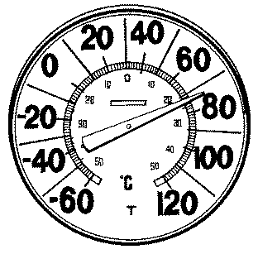
Negative Numbers Are Used to Measure Temperature

Slide 7
Hint
If you don’t see a negative or positive sign in front of a number it is positive.
+
9

Slide 8
Integer Addition Rules
Rule #1 – If the signs are the same, pretend the signs aren’t there. Add the numbers and then put the sign of the addends in front of your answer.
9 + 5 = 14
-9 + -5 = -14

Slide 9
Solve the Problems
-3 + -5 =
4 + 7 =
(+3) + (+4) =
-6 + -7 =
5 + 9 =
-9 + -9 =
-8
11
7
-13
14
-18

Slide 10
Integer Addition Rules
Rule #2 – If the signs are different pretend the signs aren’t there. Subtract the smaller from the larger one and put the sign of the larger one in front of your answer.
-9 + +5 =
Larger number
9 - 5 = 4
Answer = - 4

Slide 11
Solve These Problems
3 + -5 =
-4 + 7 =
(+3) + (-4) =
-6 + 7 =
5 + -9 =
-9 + 9 =
5 – 3 = 2
-2
7 – 4 = 3
3
4 – 3 = 1
-1
7 – 6 = 1
1
9 – 5 = 4
-4
9 – 9 = 0
0

Slide 12
One Way to Add Integers Is With a Number Line
When the number is positive count
to the right.
When the number is negative count
to the left.
-
+
-6
-5
-4
-3
-2
-1
0
1
2
3
4
5
6

Slide 13
One Way to Add Integers Is With a Number Line
+3 + -5 =
-2
+
-6
-5
-4
-3
-2
-1
0
1
2
3
4
5
6
-

Slide 14
One Way to Add Integers Is With a Number Line
+6 + -4 =
+2
+
-6
-5
-4
-3
-2
-1
0
1
2
3
4
5
6
-

Slide 15
One Way to Add Integers Is With a Number Line
+3 + -7 =
-4
+
-6
-5
-4
-3
-2
-1
0
1
2
3
4
5
6
-

Slide 16
One Way to Add Integers Is With a Number Line
-3 + +7 =
+4
-
-6
-5
-4
-3
-2
-1
0
1
2
3
4
5
6
+

