Slide 1
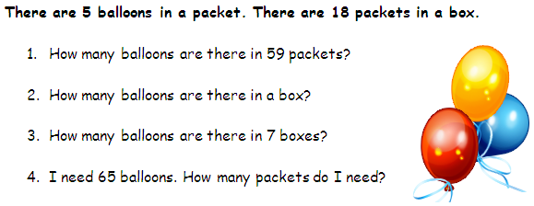
20th May 2011
Objective: to be able to use a calculator
Starter 1 -Answer the following with your calculator

Slide 2
Answers
295
90
630
13

Slide 3
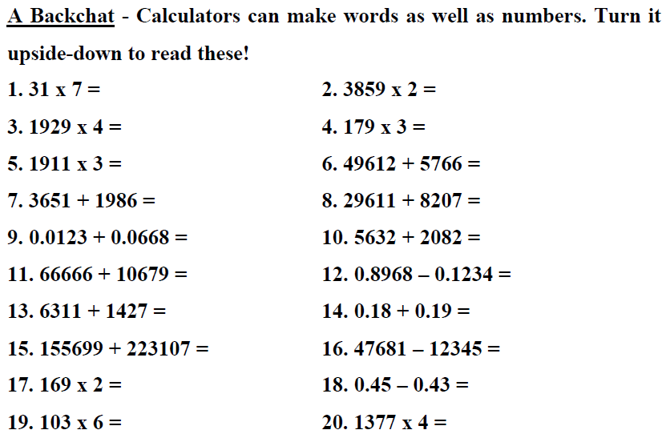
Starter 2

Slide 4
Answers
Liz
Bill
Gill
les
eels
bless
legs
bible
Igloo
Hill
Shell
Hello
Bell
Leo
Gobble
Geese
Bee
Zoo
Big
boss

Slide 5
Task 1
Pick a number between 1-9
Multiply your number by 9
Multiply your number by 12345679
What do you get?

Slide 6
Task 2 – I know your birthday....
Using your calculator
Enter the number 7
Multiply by the month of your birth
Subtract 1
Multiply by 13
Add the day of your birth
Add 3
Multiply by 11
Subtract the month of your birth
Subtract the day of your birth
Divide by 10
Add 11
Divide by 100
Now tell me your number?

Slide 7
Task 3 – Lucky 7, Unlucky 13
Chose a 3 digit number. (123)
Enter it twice in your calculator (123123)
Divide by 11
Divide by 13
Divide by your original number
What do you get?

Slide 8
Watch this
Enter your original three-digit number twice on your calculator.
Divide that number by 11.
Now divide your result by 7.
Divide your answer by your original three digit number. What do you get?

Slide 9
Why does this work?
Entering a three-digit number twice
For example: 123123 is the same as multiplying it by 1001.
123 x 1001 = 123,123.
Because 1001 = 7 x 11 x 13, the six-digit number will be divisible by 7, 11, 13, and your original three-digit number.

Slide 10
Task 4 – Number between 1-20
Enter the secret number
Multiply by 3
Add the secret number,
Subtract 5.
Multiply by 3, then
multiply by 3 again.
Add the secret number
Subtract the number of their favorite month
Multiply by 3
Then multiply by 3 again,
Then again a third time.
Add the secret number
Subtract their favorite day of the month
Notes:
Now, I show you the result. In your head (this is easy), you throw away the last three digits (9492), and add 2 (9+2=11 Tadaaah!) You put on your best mathemagical frown of genius concentration, the announce the answer! I stand amazed! I bow to your superior intellect! (Just don't tell me the last two steps, or you'll give it all away :-)

Slide 11
Task 5 – how do you want to be paid
You are offered a Job for 7 weeks. Choose your salary.
Either, you get $100 for the first day, $200 for the second day, $300 for the third day. Each day you are paid $100 more than the day before
Or, you get 1¢ for the first day, 2¢ for the second day, 4¢ for the third day. Each day you are paid double what you were paid the day before

