Slide 1
1B_Ch11(1)

Slide 2
1B_Ch11(2)
11.1 The Meaning of Congruence
A
Congruent Figures
B
Transformation and Congruence
C
Congruent Triangles
Index

Slide 3
1B_Ch11(3)
11.2 Conditions for Triangles to be Congruent
A
Three Sides Equal
B
Two Sides and Their Included Angle Equal
C
Two Angles and One Side Equal
D
Two Right-angled Triangles with Equal Hypotenuses and Another Pair of Equal Sides
Index

Slide 4
1B_Ch11(4)
11.3 The Meaning of Similarity
A
Similar Figures
B
Similar Triangles
Index

Slide 5
1B_Ch11(5)
11.4 Conditions for Triangles to be Similar
A
Three Angles Equal
B
Three Sides Proportional
C
Two Sides Proportional and their Included Angle Equal
Index

Slide 6
11.1 The Meaning of Congruence
1B_Ch11(6)
Example
A)
Congruent Figures
Two figures having the same shape and the same size are called congruent figures.
E.g. The figures X and Y as shown are congruent.
X
Y
2. If two figures are congruent, then they will fit exactly on each other.
Index 11.1
Index

Slide 7
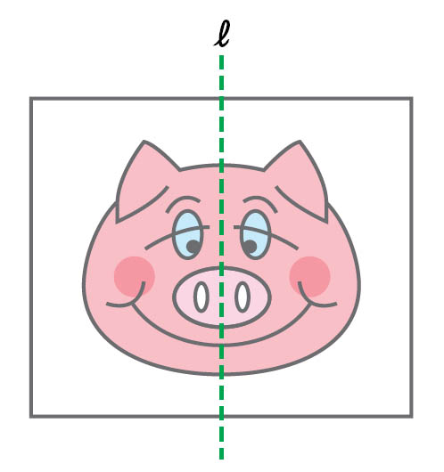
11.1 The Meaning of Congruence
1B_Ch11(7)
The figure on the right shows a symmetric figure with l being the axis of symmetry. Find out if there are any congruent figures.
The line l divides the figure into 2 congruent figures, i.e. and are congruent figures.
Therefore, there are two congruent figures.
Index

Slide 8
11.1 The Meaning of Congruence
1B_Ch11(8)
Find out by inspection the congruent figures among the following.
A
B
C
D
E
F
G
H
B, D ;
C, F
Key Concept 11.1.1
Index

Slide 9
11.1 The Meaning of Congruence
1B_Ch11(9)
Example
B)
Transformation and Congruence
‧ When a figure is translated, rotated or reflected, the image produced is congruent to the original figure. When a figure is enlarged or reduced, the image produced will NOT be congruent to the original one.
Index 11.1
Index

Slide 10
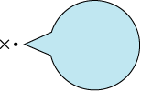
11.1 The Meaning of Congruence
1B_Ch11(10)
In each of the following pairs of figures, the red one is obtained by transforming the blue one about the fixed point x. Determine
(i) which type of transformation (translation, rotation, reflection, enlargement, reduction) it is,
(ii) whether the two figures are congruent or not.
(a)
____________
____________
Reflection
Yes
Index

Slide 11
11.1 The Meaning of Congruence
1B_Ch11(11)
Back to Question
(b)
____________
____________
Translation
Yes
(c)
____________
____________
Enlargement
No
Index

Slide 12
11.1 The Meaning of Congruence
1B_Ch11(12)
Back to Question
(d)
____________
____________
Rotation
Yes
(e)
____________
____________
Reduction
No
Key Concept 11.1.2
Index

Slide 13
11.1 The Meaning of Congruence
1B_Ch11(13)
Example
C)
Congruent Triangles
‧ When two triangles are congruent, all their corresponding sides and corresponding angles are equal.
E.g. In the figure, if △ABC ≅ △XYZ,
C
then
∠A = ∠X,
∠B = ∠Y,
∠C = ∠Z,
AB = XY, BC = YZ,
CA = ZX.
A
B
Z
and
X
Y
Index 11.1
Index

Slide 14
11.1 The Meaning of Congruence
1B_Ch11(14)
Name a pair of congruent triangles in the figure.
From the figure, we see that △ABC ≅ △RQP.
Index

Slide 15
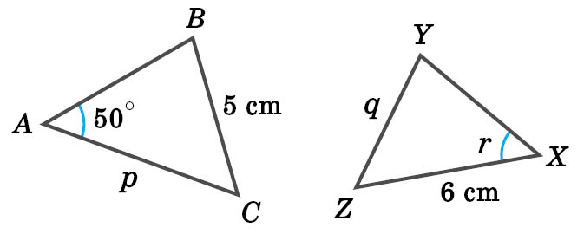
11.1 The Meaning of Congruence
1B_Ch11(15)
Given that △ABC ≅ △XYZ in the figure, find the unknowns p, q and r.
∴
For two congruent triangles, their corresponding sides and angles are equal.
∴
p = 6 cm
,
q = 5 cm
,
r = 50°
Index

Slide 16
11.1 The Meaning of Congruence
1B_Ch11(16)
Write down the congruent triangles in each of the following.
(a)
A
Y
Z
(b)
T
P
U
S
Q
B
C
X
R
(a) △ABC ≅ △XYZ
(b) △PQR ≅ △STU
Index

Slide 17
11.1 The Meaning of Congruence
1B_Ch11(17)
Find the unknowns (denoted by small letters) in each of the following.
(a) △ABC ≅ △XYZ
(b) △MNP ≅ △IJK
I
X
P
A
i
15
98°
z
35°
N
C
47°
K
13
14
M
Y
j
B
Z
x
J
(a) x = 14 ,
z = 13
(b) j = 35° ,
i = 47°
Key Concept 11.1.3
Index

Slide 18
11.2 Conditions for Triangles to be Congruent
1B_Ch11(18)
Example
A)
Three Sides Equal
‧ If AB = XY, BC = YZ and CA = ZX, then △ABC ≅ △XYZ.
【Reference: SSS】
A
X
B
C
Y
Z
Index 11.2
Index

Slide 19
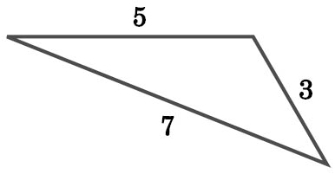
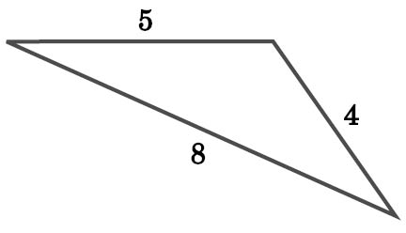
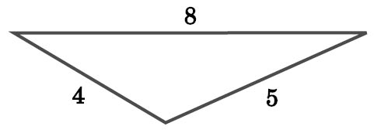
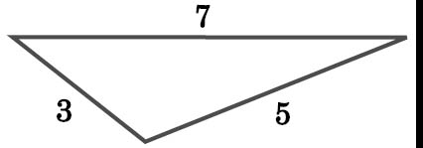
11.2 Conditions for Triangles to be Congruent
1B_Ch11(19)
Determine which pair(s) of triangles in the following are congruent.
(I)
(II)
(III)
(IV)
In the figure, because of SSS,
(I) and (IV) are a pair of congruent triangles;
(II) and (III) are another pair of congruent triangles.
Index

Slide 20
11.2 Conditions for Triangles to be Congruent
1B_Ch11(20)
Each of the following pairs of triangles are congruent. Which of them are congruent because of SSS?
A
B
5
10
7
3
18
3
5
18
7
10
B
Key Concept 11.2.1
Index

Slide 21
11.2 Conditions for Triangles to be Congruent
1B_Ch11(21)
Example
B)
Two Sides and Their Included Angle Equal
‧ If AB = XY, ∠B = ∠Y and BC = YZ, then △ABC ≅ △XYZ.
【Reference: SAS】
A
X
B
C
Y
Z
Index 11.2
Index

Slide 22
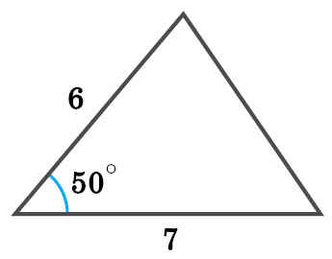
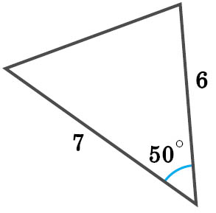
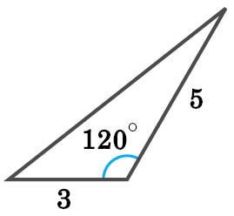
11.2 Conditions for Triangles to be Congruent
1B_Ch11(22)
Determine which pair(s) of triangles in the following are congruent.
(I)
(II)
(III)
(IV)
In the figure, because of SAS,
(I) and (III) are a pair of congruent triangles;
(II) and (IV) are another pair of congruent triangles.
Index

Slide 23
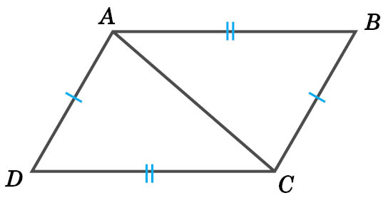
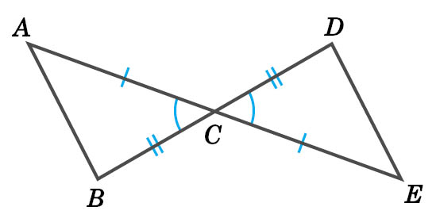
11.2 Conditions for Triangles to be Congruent
1B_Ch11(23)
In each of the following figures, equal sides and equal angles are indicated with the same markings. Write down a pair of congruent triangles, and give reasons.
(a)
(b)
Fulfill Exercise Objective
Identify congruent triangles from given diagram and give reasons.
(a) △ABC ≅ △CDA (SSS)
(b) △ACB ≅ △ECD (SAS)
Key Concept 11.2.2
Index

Slide 24
11.2 Conditions for Triangles to be Congruent
1B_Ch11(24)
Example
C)
Two Angles and One Side Equal
1. If ∠A = ∠X, AB = XY and ∠B = ∠Y, then △ABC ≅ △XYZ.
【Reference: ASA】
C
Z
A
B
X
Y
Index

Slide 25
11.2 Conditions for Triangles to be Congruent
1B_Ch11(25)
Example
C)
Two Angles and One Side Equal
2. If ∠A = ∠X, ∠B = ∠Y and BC = YZ, then △ABC ≅ △XYZ.
【Reference: AAS】
C
Z
A
B
X
Y
Index 11.2
Index

Slide 26
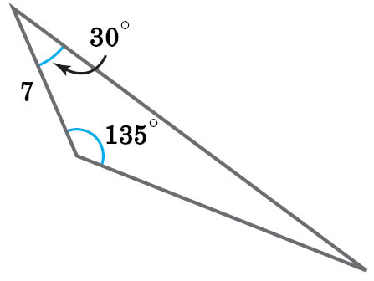
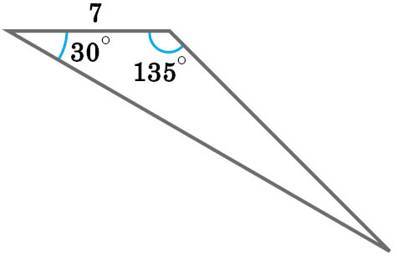
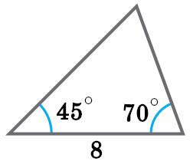
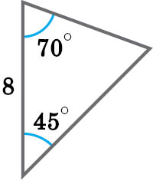
11.2 Conditions for Triangles to be Congruent
1B_Ch11(26)
Determine which pair(s) of triangles in the following are congruent.
(I)
(II)
(III)
(IV)
In the figure, because of ASA,
(I) and (IV) are a pair of congruent triangles;
(II) and (III) are another pair of congruent triangles.
Index

Slide 27
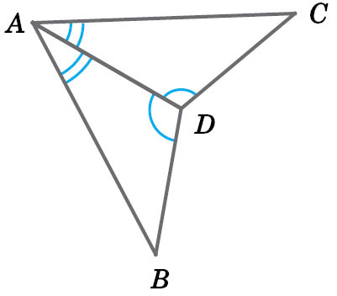
11.2 Conditions for Triangles to be Congruent
1B_Ch11(27)
In the figure, equal angles are indicated with the same markings. Write down a pair of congruent triangles, and give reasons.
△ABD ≅ △ACD (ASA)
Fulfill Exercise Objective
Identify congruent triangles from given diagram and given reasons.
Key Concept 11.2.3
Index

Slide 28
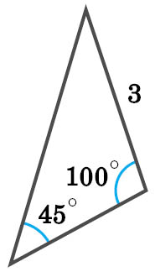
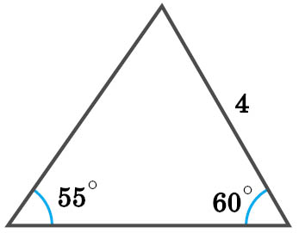
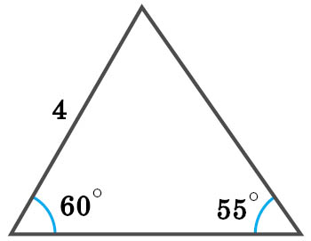
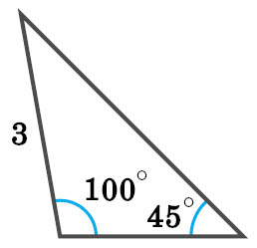
11.2 Conditions for Triangles to be Congruent
1B_Ch11(28)
Determine which pair(s) of triangles in the following are congruent.
(I)
(II)
(III)
(IV)
In the figure, because of AAS,
(I) and (II) are a pair of congruent triangles;
(III) and (IV) are another pair of congruent triangles.
Index

Slide 29
11.2 Conditions for Triangles to be Congruent
1B_Ch11(29)
In the figure, equal angles are indicated with the same markings. Write down a pair of congruent triangles, and give reasons.
A
D
B
C
△ABD ≅ △CBD (AAS)
Key Concept 11.2.4
Index

Slide 30
11.2 Conditions for Triangles to be Congruent
1B_Ch11(30)
Example
D)
Two Right-angled Triangles with Equal Hypotenuses and Another Pair of Equal Sides
‧ If ∠C = ∠Z = 90°, AB = XY and BC = YZ, then △ABC ≅ △XYZ.
【Reference: RHS】
A
X
B
C
Y
Z
Index 11.2
Index

Slide 31
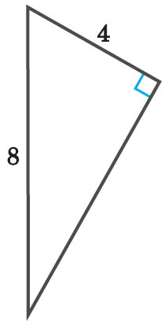
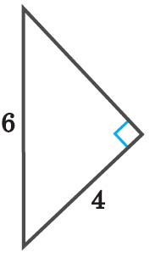
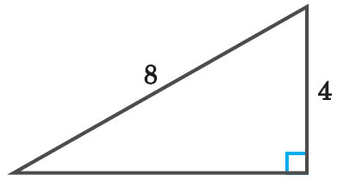
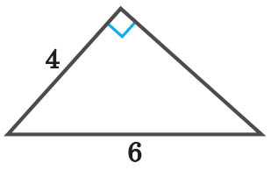
11.2 Conditions for Triangles to be Congruent
1B_Ch11(31)
Determine which of the following pair(s) of triangles are congruent.
(I)
(II)
(III)
(IV)
In the figure, because of RHS,
(I) and (III) are a pair of congruent triangles;
(II) and (IV) are another pair of congruent triangles.
Index

Slide 32
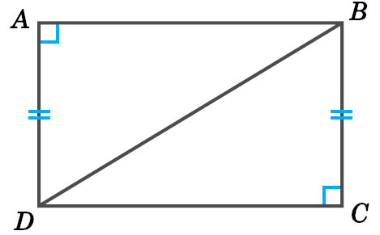
11.2 Conditions for Triangles to be Congruent
1B_Ch11(32)
In the figure, ∠DAB and ∠BCD are both right angles and AD = BC. Judge whether △ABD and △CDB are congruent, and give reasons.
Yes, △ABD ≅ △CDB (RHS)
Fulfill Exercise Objective
Determine whether two given triangles are congruent.
Key Concept 11.2.5
Index

Slide 33
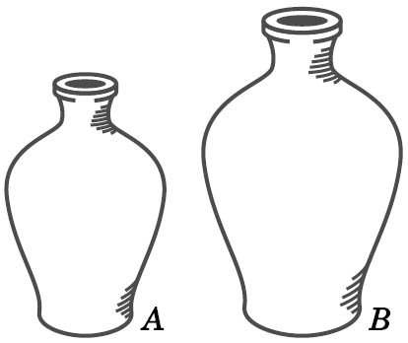
11.3 The Meaning of Similarity
1B_Ch11(33)
Example
A)
Similar Figures
1. Two figures having the same shape are called similar figures. The figures A and B as shown is an example of similar figures.
2. Two congruent figures must be also similar figures.
3. When a figure is enlarged or reduced, the new figure is similar to the original one.
Index 11.3
Index

Slide 34
11.3 The Meaning of Similarity
1B_Ch11(34)
Find out all the figures similar to figure A by inspection.
A
B
C
D
E
D, E
Key Concept 11.3.1
Index

Slide 35
11.3 The Meaning of Similarity
1B_Ch11(35)
Example
B)
Similar Triangles
1. If two triangles are similar, then
i. their corresponding angles are equal;
ii. their corresponding sides are proportional.
In the figure, if △ABC ~ △XYZ, then ∠A = ∠X, ∠B = ∠Y,
∠C = ∠Z and .
B
A
C
Y
X
Z
Index 11.3
Index

Slide 36
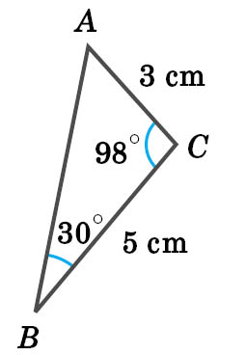
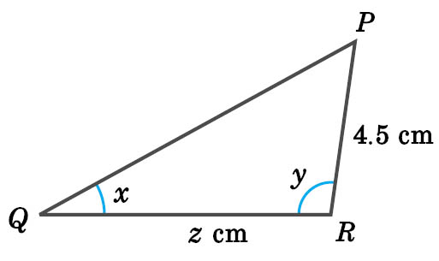
11.3 The Meaning of Similarity
1B_Ch11(36)
In the figure, given that △ABC ~ △PQR, find the unknowns x, y and z.
x = 30° ,
y = 98°
∴
=
∴
=
z =
= 7.5
Index

Slide 37
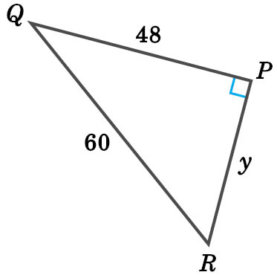
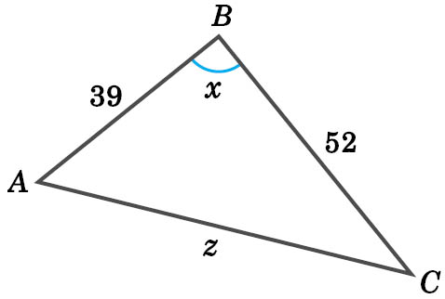
11.3 The Meaning of Similarity
1B_Ch11(37)
In the figure, △ABC ~ △RPQ. Find the values of the unknowns.
Since △ABC ~ △RPQ,
∠B = ∠P
∴
x = 90°
Index

Slide 38
11.3 The Meaning of Similarity
1B_Ch11(38)
Back to Question
Also,
=
Also,
=
=
=
= y
z =
∴
y = 36
∴
z = 65
Fulfill Exercise Objective
Find the unknowns in similar triangles.
Key Concept 11.3.2
Index

Slide 39
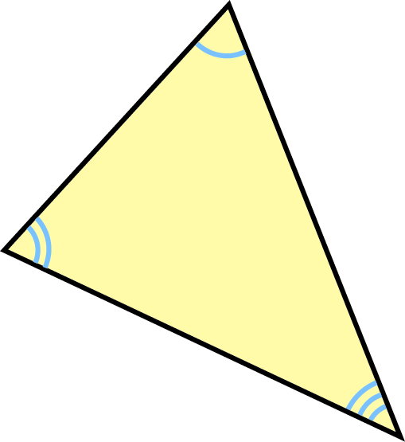
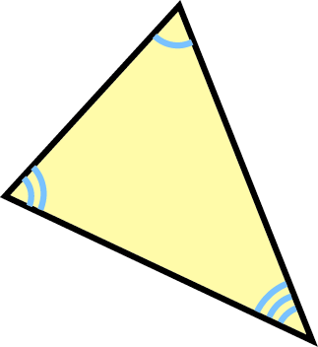
11.4 Conditions for Triangles to be Similar
1B_Ch11(39)
Example
A)
Three Angles Equal
‧ If two triangles have three pairs of equal corresponding angles, then they must be similar.
【Reference: AAA】
Index 11.4
Index

Slide 40
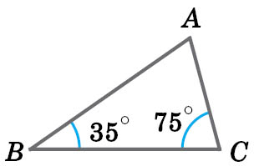
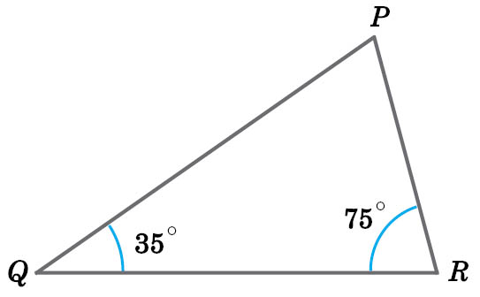
11.4 Conditions for Triangles to be Similar
1B_Ch11(40)
Show that △ABC and △PQR in the figure are similar.
In △ABC and △PQR as shown,
∠B = ∠Q, ∠C = ∠R,
∠A
= 180° – 35° – 75°
= 70°
∠sum of Δ
∠P
= 180° – 35° – 75°
= 70°
∴ ∠A = ∠P
∴ △ABC ~ △PQR (AAA)
Index

Slide 41
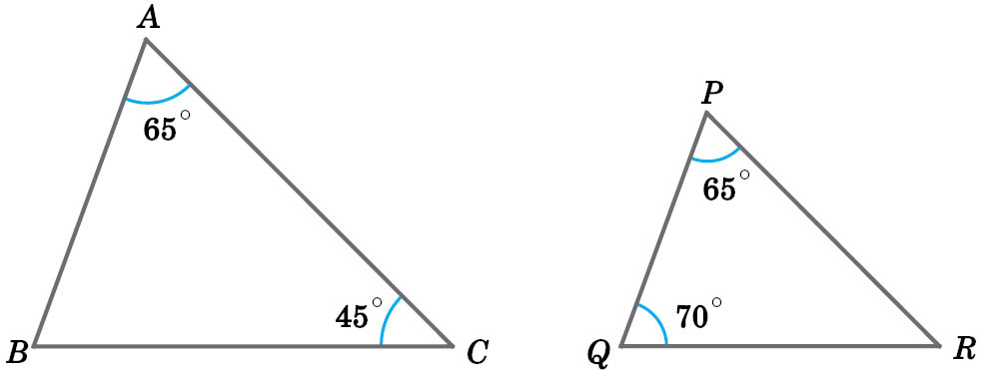
11.4 Conditions for Triangles to be Similar
1B_Ch11(41)
Are the two triangles in the figure similar? Give reasons.
【In △ABC, ∠B = 180° – 65° – 45° = 70°
In △PQR, ∠R = 180° – 65° – 70° = 45°】
Fulfill Exercise Objective
Identify similar triangles from given diagram and give reasons.
Yes, △ABC ~ △PQR (AAA).
Key Concept 11.4.1
Index

Slide 42
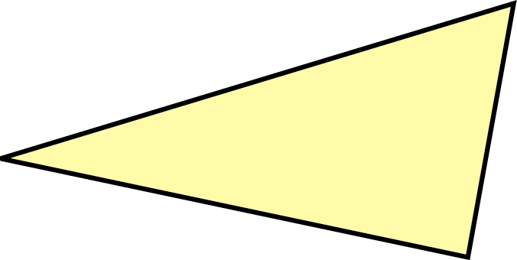
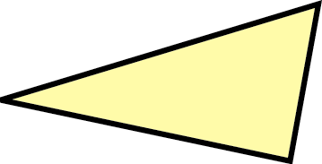
11.4 Conditions for Triangles to be Similar
1B_Ch11(42)
Example
B)
Three Sides Proportional
‧ If the three pairs of sides of two triangles are proportional, then the two triangles must be similar.
【Reference: 3 sides proportional】
a
c
d
f
b
e
Index 11.4
Index

Slide 43
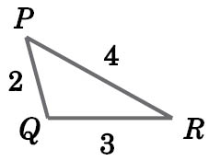
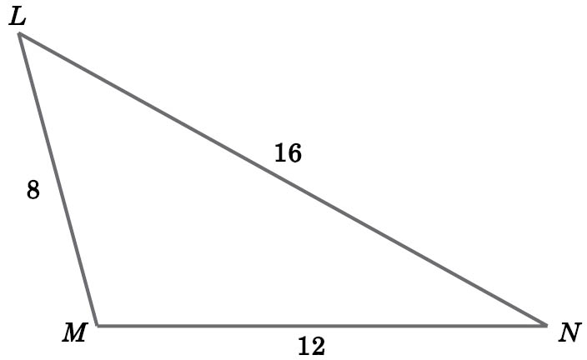
11.4 Conditions for Triangles to be Similar
1B_Ch11(43)
Show that △PQR and △LMN in the figure are similar.
In △PQR and △LMN as shown,
,
,
∴
∴ △PQR ~ △LMN (3 sides proportional)
Index

Slide 44
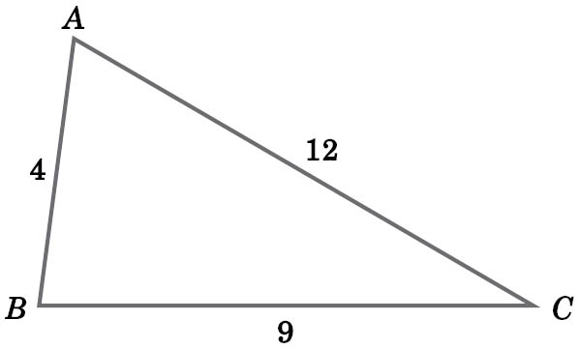
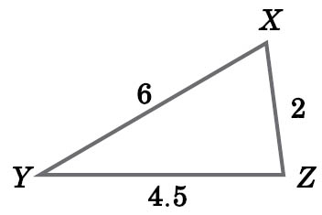
11.4 Conditions for Triangles to be Similar
1B_Ch11(44)
Are the two triangles in the figure similar? Give reasons.
【
,
,
】
Fulfill Exercise Objective
Determine whether two given triangles are similar.
Yes, △ABC ~ △XZY (3 sides proportional).
Key Concept 11.4.2
Index

Slide 45
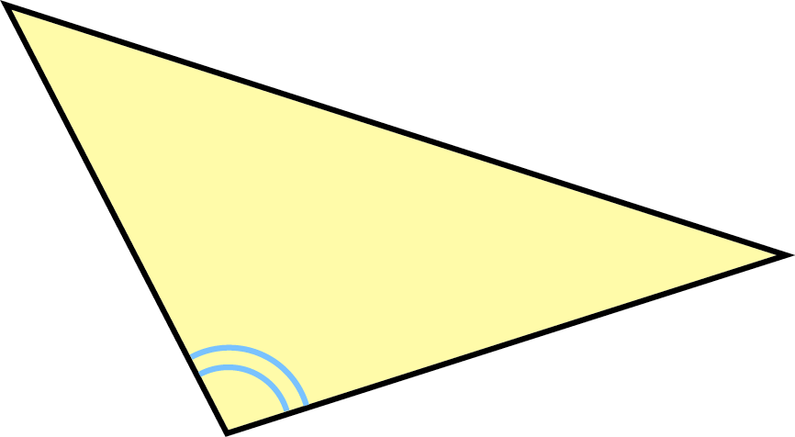
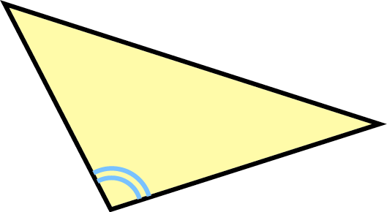
11.4 Conditions for Triangles to be Similar
1B_Ch11(45)
Example
C)
Two Sides Proportional and their Included Angle Equal
‧ If two pairs of sides of two triangles are proportional and their included angles are equal, then the two triangles are similar.
【Reference: ratio of 2 sides, inc.∠】
p
r
x
y
q
s
Index 11.4
Index

Slide 46
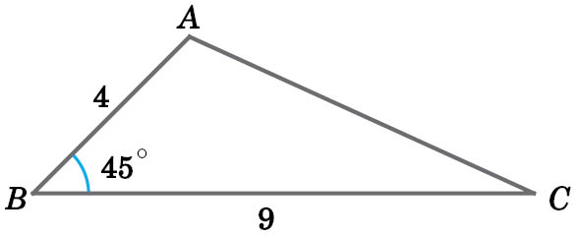
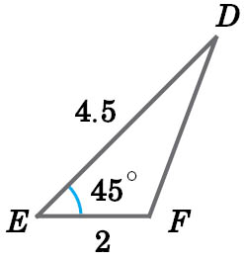
11.4 Conditions for Triangles to be Similar
1B_Ch11(46)
Show that △ABC and △FED in the figure are similar.
In △ABC and △FED as shown,
∠B = ∠E
,
∴
∴ △ABC ~ △FED (ratio of 2 sides, inc.∠)
Index

Slide 47
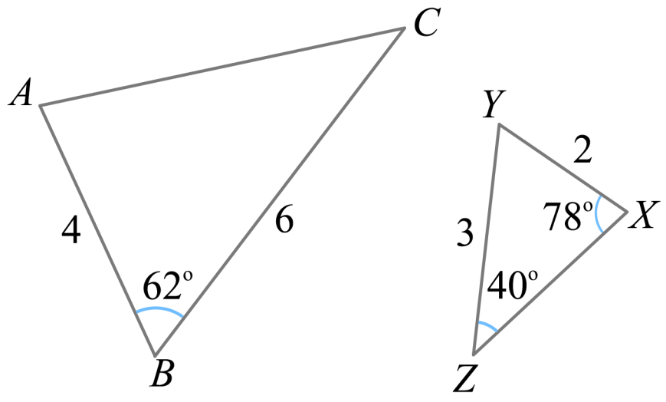
11.4 Conditions for Triangles to be Similar
1B_Ch11(47)
Are the two triangles in the figure similar? Give reasons.
【 ∠ZYX = 180° – 78° – 40° = 62°, ∠ZYX = ∠CBA = 62°,
,
】
Yes, △ABC ~ △XYZ (ratio of 2 sides, inc.∠).
Key Concept 11.4.3
Index

